Slide 1

CS302 Design and Analysis of Algorithms
Muhammad sohail afzal

Slide 2
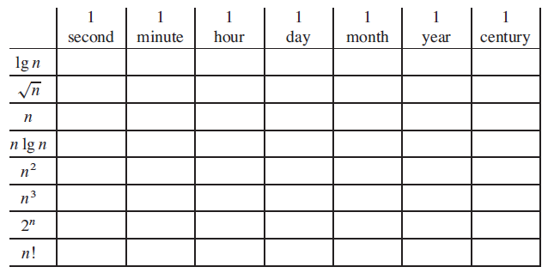
How did you solve the task !
Comparison of running times
For each function f (n) and time t in the following table, determine the largest size n of a problem that can be solved in time t, assuming that the algorithm to solve the problem takes f(n) microseconds.

Slide 3
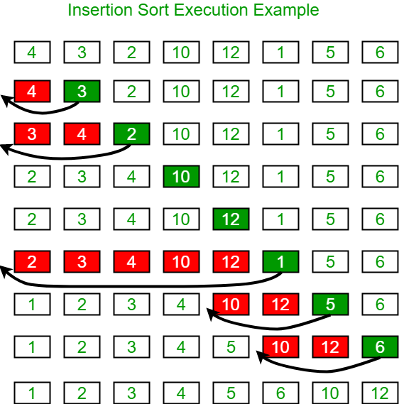
Insertion Sort – Only For Overview Right Now

Slide 4
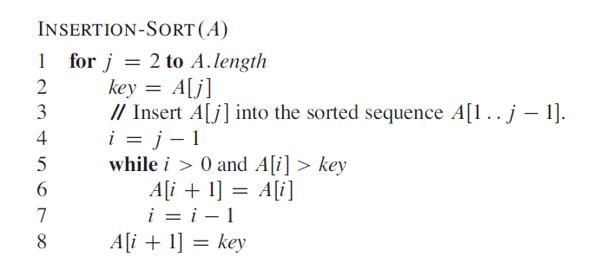
Insertion Sort – Only For Overview Right Now

Slide 5
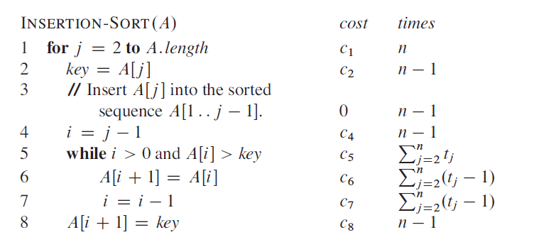
Insertion Sort – Only For Overview Right Now

Slide 6
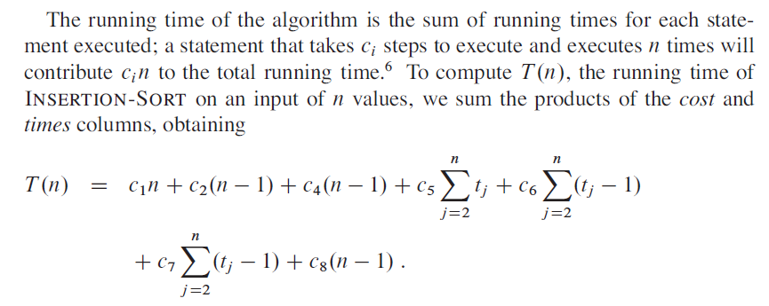
Insertion Sort – Only For Overview Right Now

Slide 7
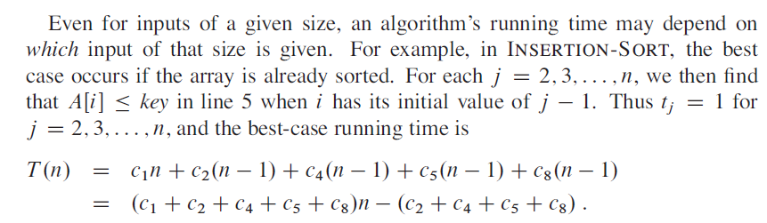
Insertion Sort – Only For Overview Right Now
Best Case Time :

Slide 8
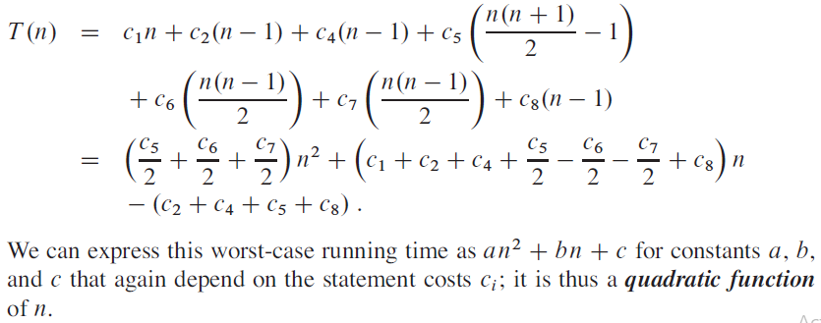
Insertion Sort – Only For Overview Right Now
Worst Case Time :

Slide 9
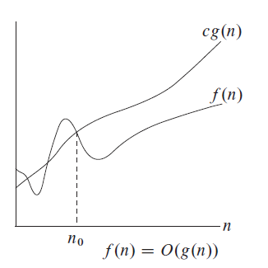
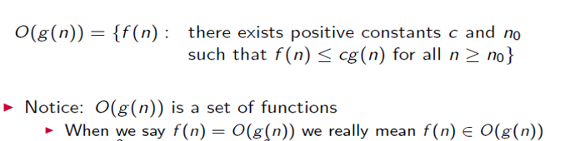
Asymptotic Notation - Big O - Overview
Definition:

Slide 10
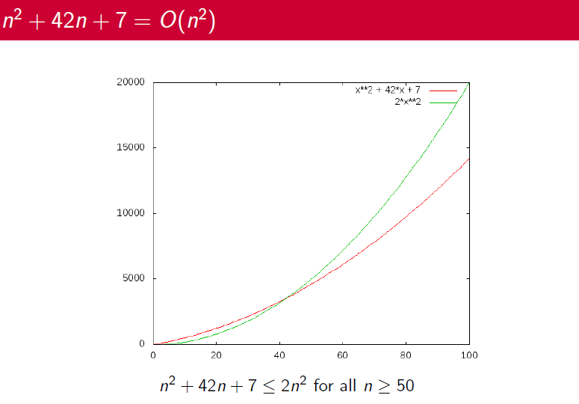
Asymptotic Notation - Big O - Overview

Slide 11
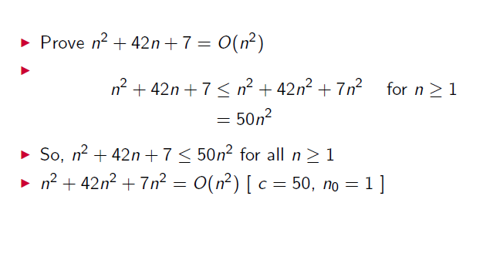
Asymptotic Notation - Big O - Overview
Example :

Slide 12
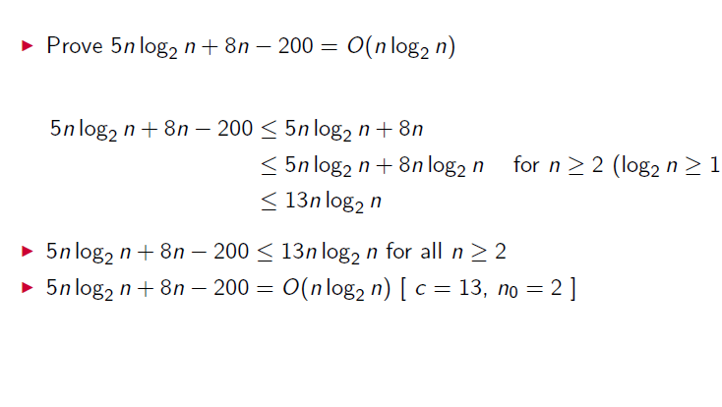
Asymptotic Notation - Big O - Overview
Example :

Slide 13
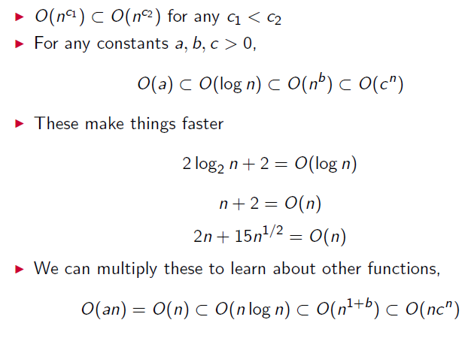
Asymptotic Notation - Big O - Overview
Some Common Relations :

Slide 14
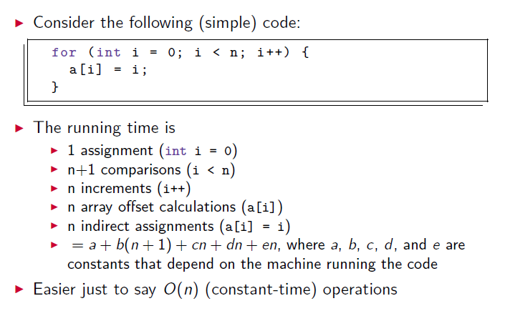
Asymptotic Notation - Big O - Overview
Why use Big O notation ?

